Slide 1
Using ErWin
Generating SQL from an ERWin model

Slide 2
Setting the constraints
Make sure you name your constraints as we did for CA Part I

Slide 3
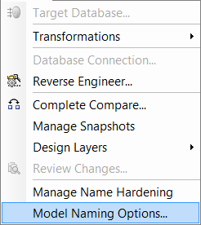
Setting the names of primary & foreign keys
To make life a little easier we will use the Model Naming Options under the Actions menu

Slide 4
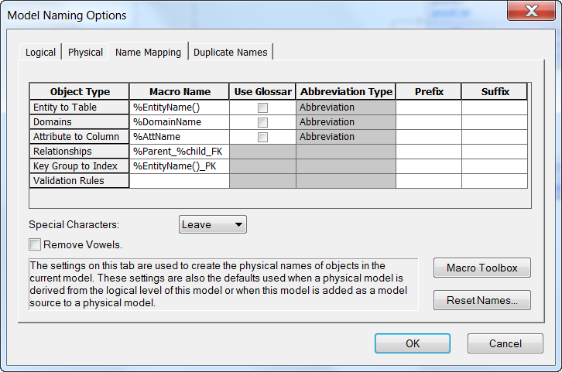
Setting the names of primary & foreign keys
Click the Name Mapping Tab
Change the values for Relationships and Key Group to Index to those shown in the dialog below

Slide 5
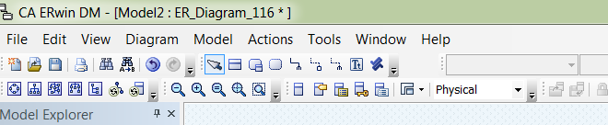
Generate SQL
Change the model to physical

Slide 6
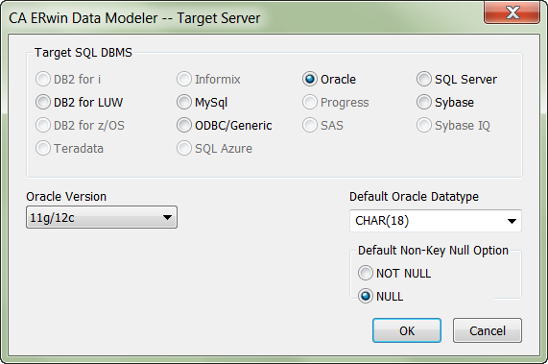
Setting Target Database
ERWin can generate SQL to work with many different Relational DBs
You need to make sure that your Target Database is set correctly before generating your SQL
In Physical Model View Select Actions->Target Database

Slide 7
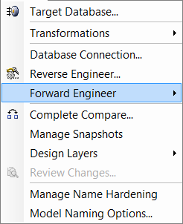
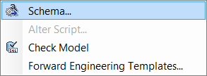
Generate SQL
From the Actions menu pick ‘Forward Engineer’
Choose SCHEMA from the options presented.
Work through the options presented in the following screens and make sure your selections match those presented.

Slide 8

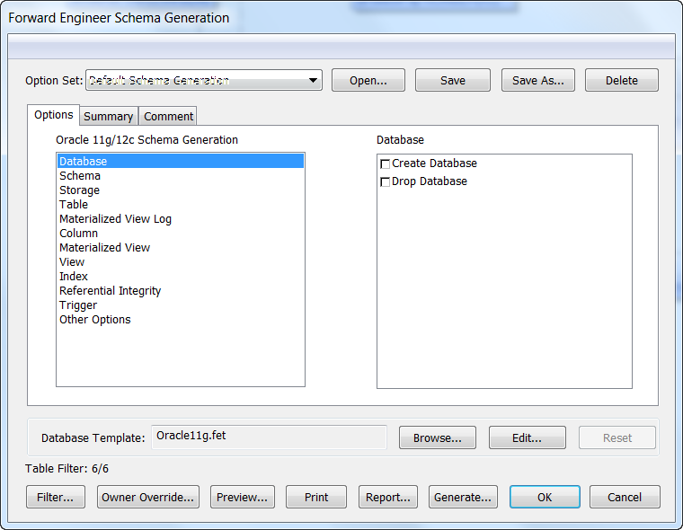
Database option – clear all
You don’t want to create a new database so make sure these are not clicked.

Slide 9
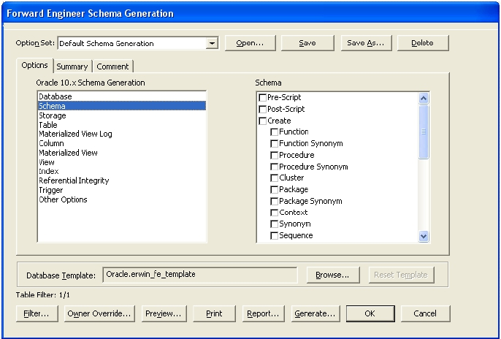
Schema options – clear all
You don’t want to interfere with your schema. You only want to create the tables and relationships between them. So make sure none are selected

Slide 10
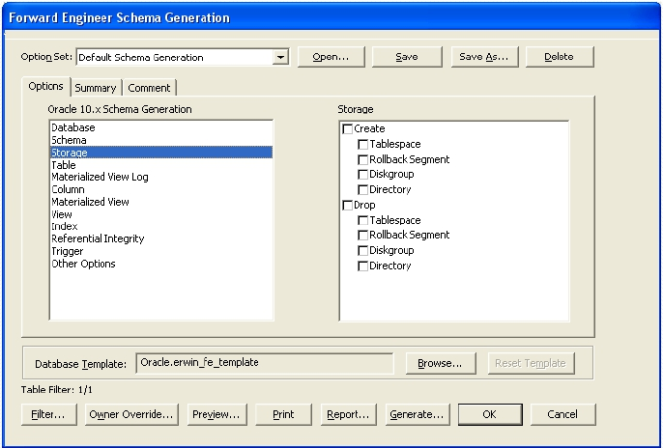
Storage Option – clear all

Slide 11
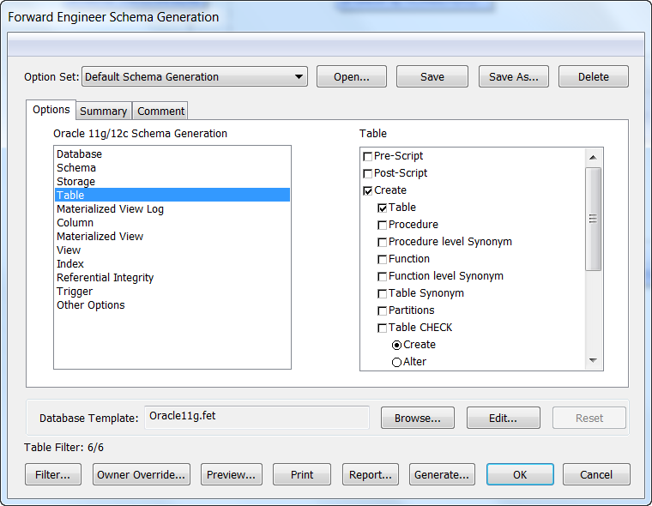
Table options – You need to Make Some Choices
This is where you need to do some work. You need to click Create Table (but only that)
So that you can reuse this SQL you want to delete any tables with the same names and create them again.

Slide 12
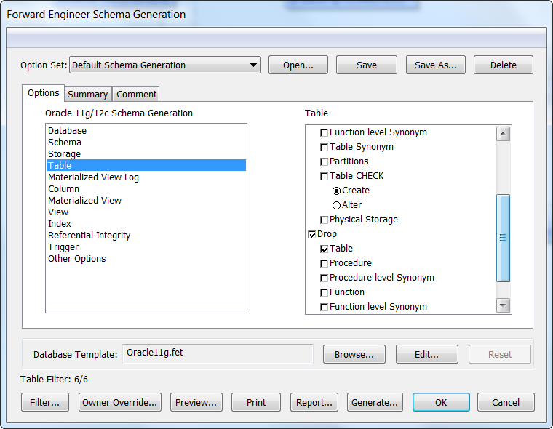
Table options – You need to Make Some Choices
So that you can reuse this SQL you want to delete any tables with the same names and create them again.

Slide 13
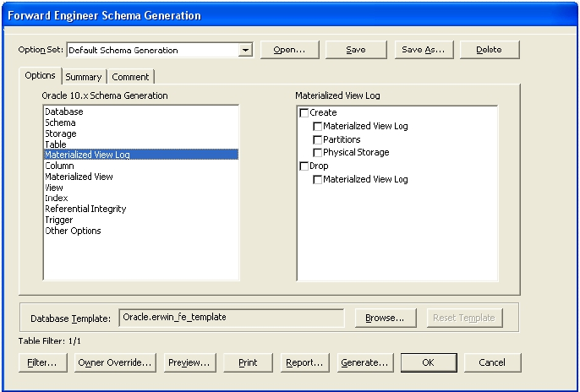
Materialised View Log – clear all options

Slide 14
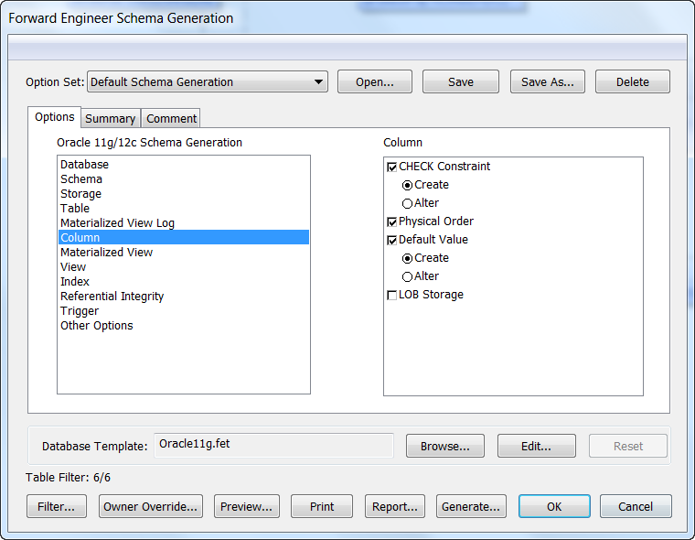
Column options – You need to customise
Make sure you include the generation of any constraints or defaults you created.
Make sure you choose to have these included in your CREATE Table by clicking the Create Radio button

Slide 15
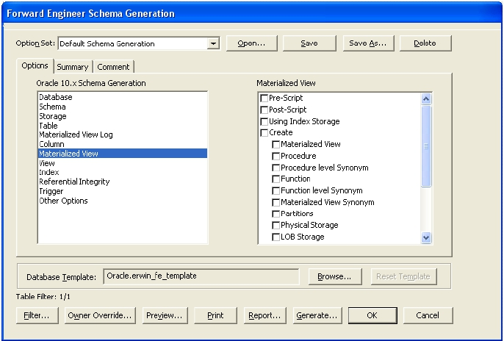
Materialised View – clear all

Slide 16
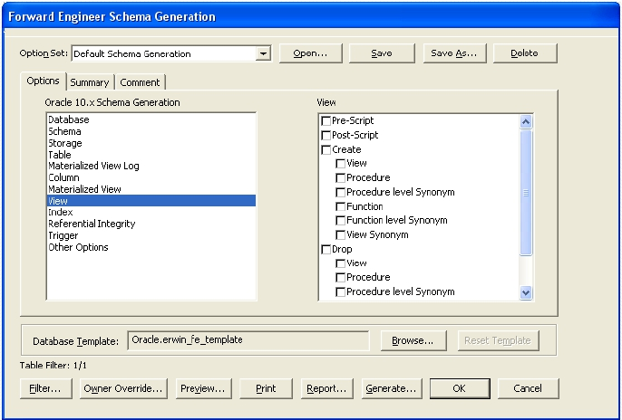
View – clear all

Slide 17
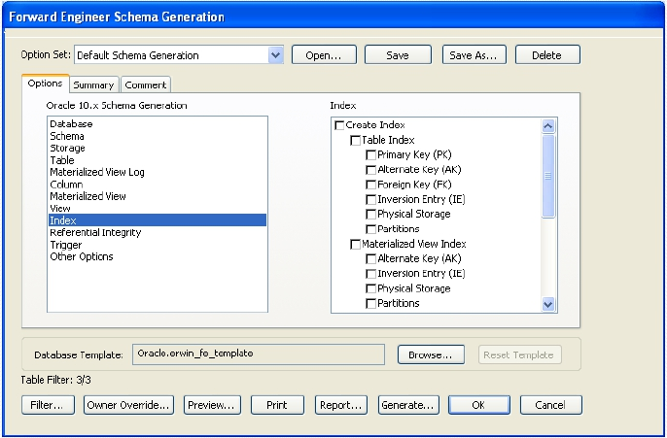
Index options – clear all

Slide 18
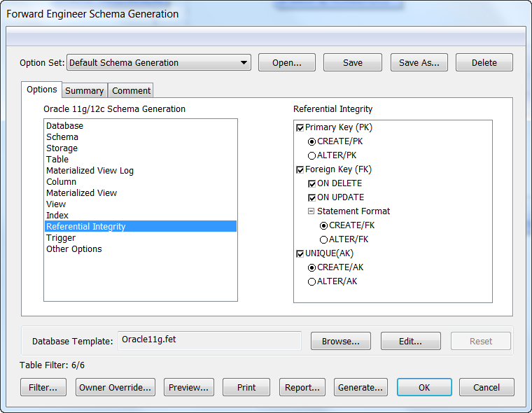
Referential Integrity - Customise
This is where you tell ERWin where to handle the create for primary keys and foreign keys.
Make sure you click Create/PK, Create/FK and Create/AK

Slide 19
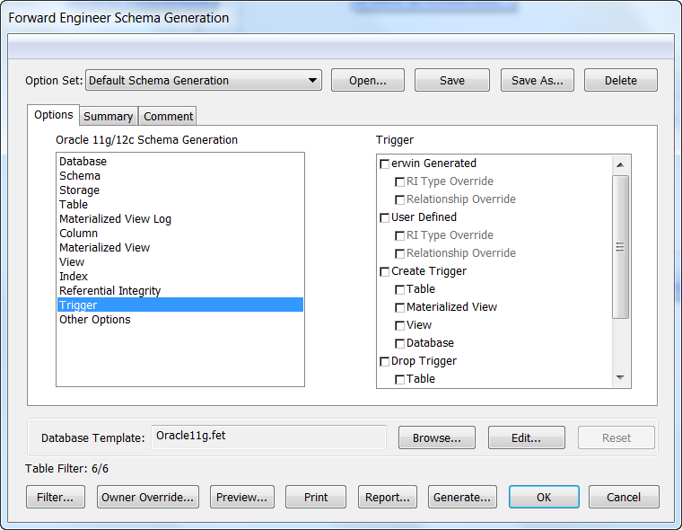
Trigger – clear all

Slide 20
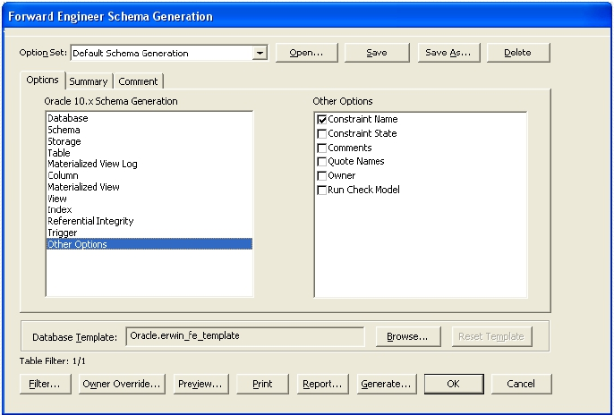
Other options - customise

Slide 21
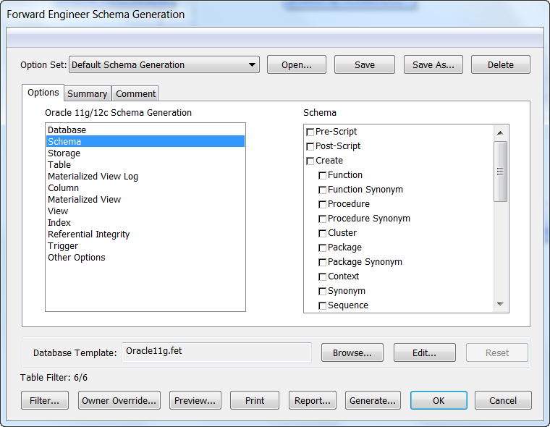
Generate the SQL
Now you are ready to generate the SQL
We are not going to set up DB connections so the easiest way is to click the Preview button at the bottom of the screen

Slide 22
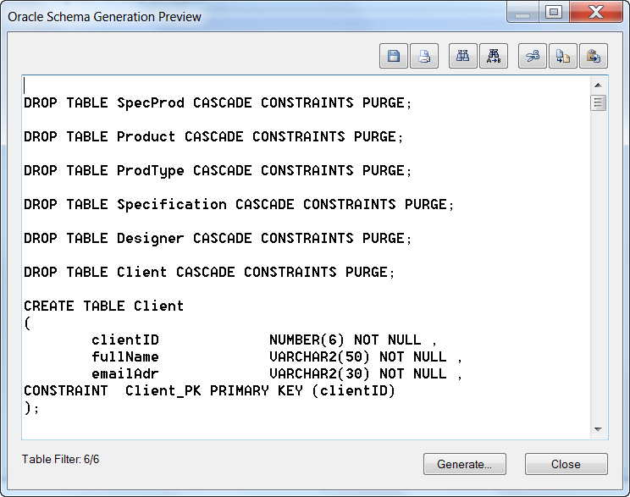
Preview
This will show you the SQL that has been generated
You need to check to make sure it is doing what you want it to do

Slide 23
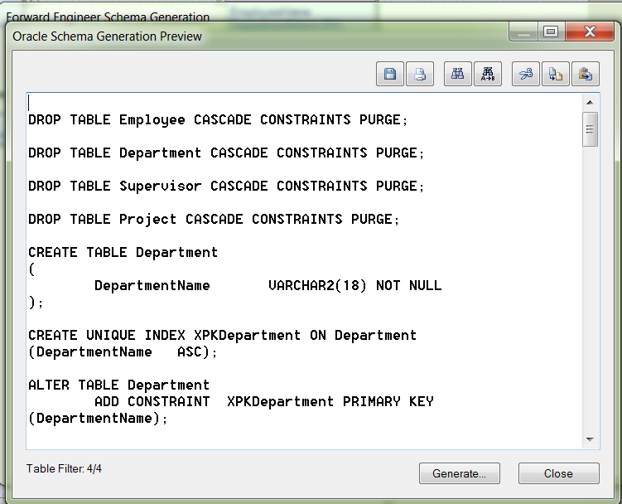
To save your ‘CREATE’s
Either Save the SQL as a file (pick a name for your code and store it with suffix of .sql)
OR you can select all the SQL (right click in the window and choose Select All) then copy/cut and paste using the buttons at the top.
You can now use this SQL in SQL Developer and it will create the tables for you.

Slide 24
Reverse Engineering From a SQL Script
Open ERWin as before
Setup a new physical/logical model
From Actions -> Reverse Engineering and hit Next

Slide 25
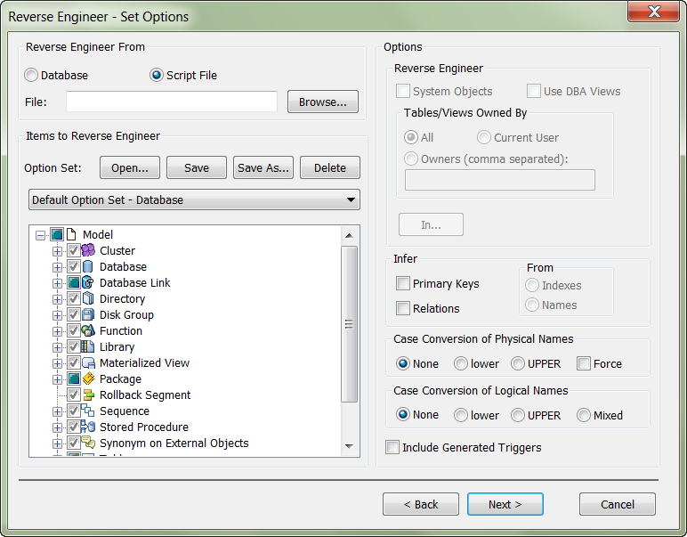
Reverse Engineer from Script
Click Radio button next to Script File, then Browse for your SQL File and click Next

Slide 26
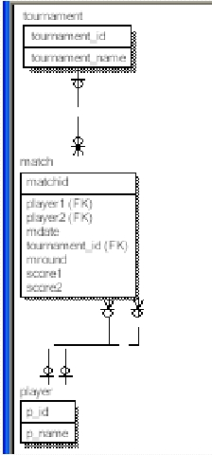
Result
RESULT
 You may need to
rearrange the tables or
change the notation or
formatting, but all the
other information is in
your model.

